Slide 1
Module 4: Playbook Special Topics

Slide 2
Identify
Define

Slide 3
Topic List
Debugging strategy
Error Handling
Check Mode
Rolling update batch size
Showing differences

Slide 4
Topic List
Debugging strategy
Topic 2
Topic 3
Topic 4
Topic 5
Topic 6
Topic 7

Slide 5
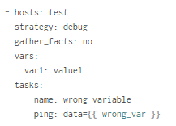
Debugging
Debugging strategy
This strategy enables you to invoke a debugger when a task has failed
example, check or set the value of variables, update module arguments, and re-run the failed task with the new variables and arguments to help resolve the cause of the failure
To use the debug strategy change the strategy attribute like this:
- hosts: test
strategy: debug
tasks:
...
For example, run the playbook below

Slide 6

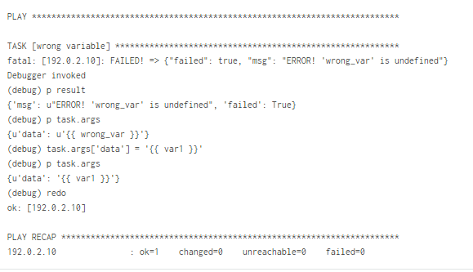
Debugging
Debugging strategy
The debugger is invoked since the wrong_var variable is undefined.
Let’s change the module’s arguments and run the task again
This time the task runs successfully

Slide 7
Topic List
Topic 1
Error Handling
Topic 3
Topic 4
Topic 5
Topic 6
Topic 7

Slide 8
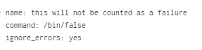
Error Handling
Ignoring failed commands
Generally playbooks will stop executing any more steps on a host that has a task fail. Sometimes, though, you want to continue on. To do so, write a task that looks like this:
Note that the above system only governs the return value of failure of the particular task, so if you have an undefined variable used or a syntax error, it will still raise an error that users will need to address. Note that this will not prevent failures on connection or execution issues. This feature only works when the task must be able to run and return a value of ‘failed’.

Slide 9
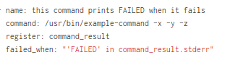
Error Handling
Resetting unreachable hosts, handlers and failure
Connection failures set hosts as ‘UNREACHABLE’, which will remove them from the list of active hosts for the run. To recover from these issues you can use meta: clear_host_errors to have all currently flagged hosts reactivated, so subsequent tasks can try to use them again.
When a task fails on a host, handlers which were previously notified will not be run on that host. This can lead to cases where an unrelated failure can leave a host in an unexpected state. For example, a task could update a configuration file and notify a handler to restart some service. If a task later on in the same play fails, the service will not be restarted despite the configuration change.
You can change this behavior with the --force-handlers command-line option, or by including force_handlers: True in a play, or force_handlers = True in ansible.cfg. When handlers are forced, they will run when notified even if a task fails on that host. (Note that certain errors could still prevent the handler from running, such as a host becoming unreachable.)
Suppose the error code of a command is meaningless and to tell if there is a failure what really matters is the output of the command, for instance if the string “FAILED” is in the output.
Ansible in 1.4 and later provides a way to specify this behavior as follows:

Slide 10
Topic List
Topic 1
Galaxy
Check Mode
Topic 4
Topic 5
Topic 6
Topic 7

Slide 11

Check Mode (“Dry Run”)
Enabling or disabling check mode for tasks
When ansible-playbook is executed with --check it will not make any changes on remote systems. Instead, any module instrumented to support ‘check mode’ (which contains most of the primary core modules, but it is not required that all modules do this) will report what changes they would have made rather than making them. Other modules that do not support check mode will also take no action, but just will not report what changes they might have made.
Check mode is just a simulation, and if you have steps that use conditionals that depend on the results of prior commands, it may be less useful for you. However it is great for one-node-at-time basic configuration management use cases.
Sometimes you may want to modify the check mode behavior of individual tasks. This is done via the check_mode option, which can be added to tasks. There are two options:
Force a task to run in check mode, even when the playbook is called without --check. This is called check_mode: yes.
Force a task to run in normal mode and make changes to the system, even when the playbook is called with --check. This is called check_mode: no.

Slide 12
Topic List
Topic 1
Topic 1
Topic 1
Rolling update batch size
Topic 5
Topic 6
Topic 7

Slide 13
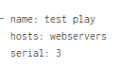
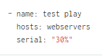
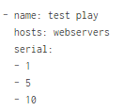
Rolling update batch size
By default, Ansible will try to manage all of the machines referenced in a play in parallel. For a rolling updates use case, you can define how many hosts Ansible should manage at a single time by using the ‘’serial’’ keyword:
In the above example, if we had 100 hosts, 3 hosts in the group ‘webservers’ would complete the play completely before moving on to the next 3 hosts.
The ‘’serial’’ keyword can also be specified as a percentage in Ansible 1.8 and later, which will be applied to the total number of hosts in a play, in order to determine the number of hosts per pass:
If the number of hosts does not divide equally into the number of passes, the final pass will contain the remainder.
As of Ansible 2.2, the batch sizes can be specified as a list, as follows:

Slide 14
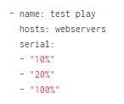
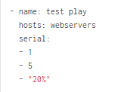
Rolling update batch size
In the above example, the first batch would contain a single host, the next would contain 5 hosts, and (if there are any hosts left), every following batch would contain 10 hosts until all available hosts are used.
It is also possible to list multiple batche sizes as percentages:
You can also mix and match the values:

Slide 15
Topic List
Topic 1
Topic 1
Topic 1
Topic
Showing differences
Topic 6
Topic 7

Slide 16

Showing differences with --diff
The --diff option to ansible-playbook works great with --check (detailed above) but can also be used by itself. When this flag is supplied, if any templated files on the remote system are changed, and the ansible-playbook CLI will report back the textual changes made to the file (or, if used with --check, the changes that would have been made). Since the diff feature produces a large amount of output, it is best used when checking a single host at a time, like so:

Slide 17
Thank You

